Slide 1

OSI Layer 5-7: Application Layers

Slide 2
OSI Layer 5-7: Application Layers
The Session Layer
The Presentation Layer
The Application Layer

Slide 3
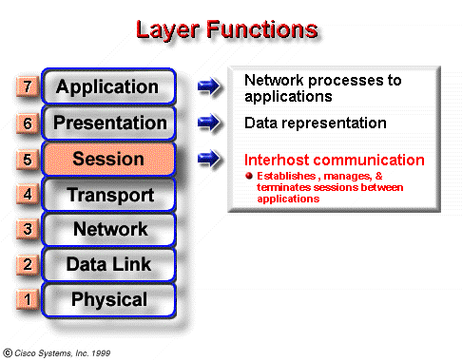
Layer 5: The Session Layer
This includes starting, stopping, and resynchronizing two computers who are having a "rap session."

Slide 4
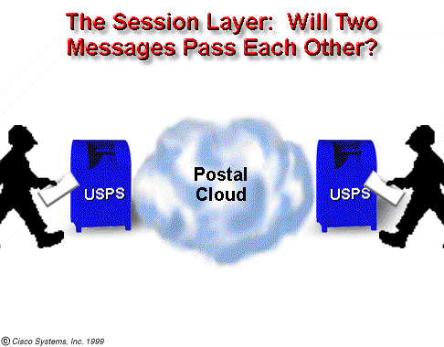
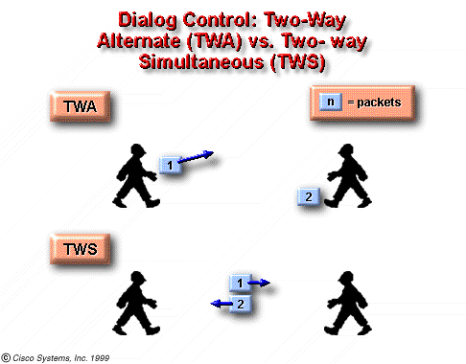
The Session Layer
two-way simultaneous communication?
two-way alternate control?
have synchronized the subjects of your conversations?

Slide 5
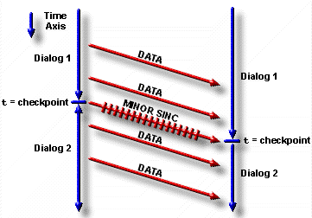
The Session Layer
Checkpoint is used to separate parts of a session, previously referred to as dialogues
Dialogue separation is the orderly initiation, termination, and managing of communication.

Slide 6
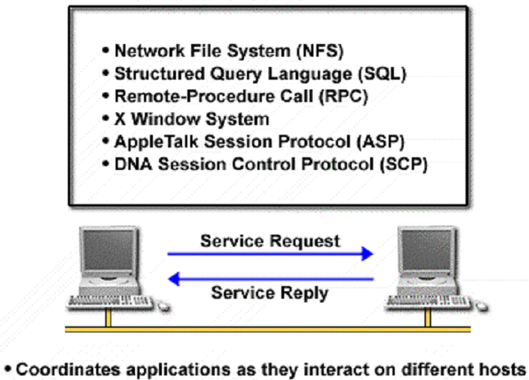
Some Applications of Layer 5

Slide 7
The Application Layers
The Session Layer
The Presentation Layer
The Application Layer

Slide 8
Layer 6 - The Presentation Layer
The presentation layer is responsible for presenting data in a form that the receiving device can understand.
The presentation layer has 3 main functions:
Data formatting
Data compression
Data encryption

Slide 9
Data Formatting
Imagine two dissimilar systems.
One uses Extended Binary Coded Decimal Interchange Code (EBCDIC) to format text
The other uses American Standard Code for Information Interchange (ASCII) to format text
Layer 6 provides the translation between these two different types of codes
Notes:
If you have any question about EBCDIC and ASCII, please refer to http://www.natural-innovations.com/computing/asciiebcdic.html

Slide 10
Graphic File Formats
The Internet often uses two binary file formats to display images:
Graphic Interchange Format (GIF)
Joint Photographic Experts Group (JPEG).
Any computer with a reader for the GIF and JPEG file formats can read these file types, regardless of the type of computer.

Slide 11
Multimedia File Format
The multimedia file format is another type of binary file, which stores sounds, music, and video.
These files may be completely downloaded, first, and then played, or they may download while they are playing.
The latter method is referred to as streaming audio.

Slide 12
Encryption & Compression
Layer 6 is responsible for data encryption.
Data encryption protects information during its transmission.
The presentation layer is also responsible for the compression of files.

Slide 13
The Application Layers
The Session Layer
The Presentation Layer
The Application Layer

Slide 14
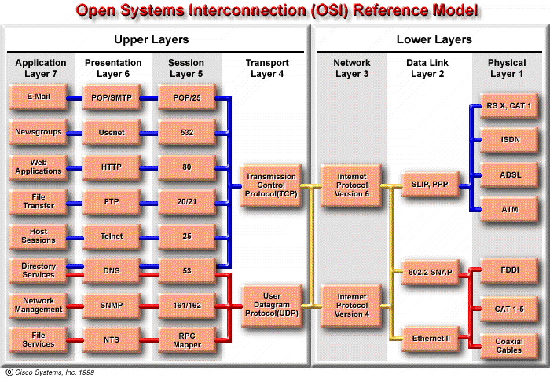

Slide 15
Layer 7: Application Layer
The application layer (closest to the user) supports the communicating component of an application.
The application layer:
Identifies and establishes the availability of intended communication partners
Synchronizes cooperating applications
Establishes agreement on procedures for error recovery
Control of data integrity

Slide 16
Layer 7: Application Layer
Provide a direct interface for the rest of the OSI model by using NETWORK APPLICATIONS (e.g. www, e-mail, ftp, telnet)
Or provide an indirect interface by using standalone applications (e.g. word processors, spreadsheets, presentation managers, network redirector).

Slide 17
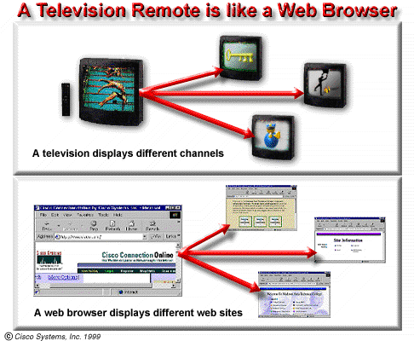
HTTP

Slide 18
FTP and TFTP
FTP is a reliable, connection-oriented service that uses TCP to transfer files.
FTP first establishes a control connection between the client and the server(port 21)
Then a second connection is established, which is a link between the computers through which the data is transferred. (port 20)
TFTP is a connectionless service that uses UDP
Small and easy to implement.
E.g. TFTP is used on routers to transfer configuration files and Cisco IOS images.

Slide 19
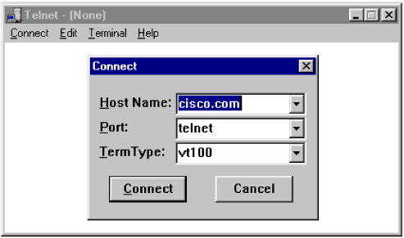
Telnet
Telnet client software provides the ability to log in to a remote Internet host that is running a Telnet server application and then to execute commands from the command line.
Notes:
对网络管理很重要的一种应用程序

Slide 20
SMTP and POP
E-mail servers communicate with each other using the SMTP to send and POP to receive mail.
SMTP (Simple Mail Transfer Protocol)
POP3 (Post Office Protocol version 3)
Notes:
大致描述email收发过程，client—server----server----client.回忆一下使用的端口smtp---25 pop3---110

Slide 21
SMTP and POP
sina.com
mail.cctv.com
Sender ISP
Receiver ISP
Sender
POP3
Receiver
SMTP
SMTP
Internet
Postbox
E-mail server
Mail cache
E-mail server
Sender：xyz5678@sina.com
Receiver ：ab30@mail.cctv.com
User name
Domain name of e-mail server
IP and TCP are transferring protocols of e-mail

Slide 22
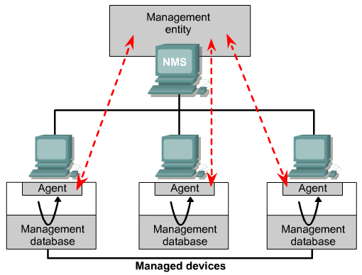
SNMP
The Simple Network Management Protocol (SNMP) is an application layer protocol that facilitates the exchange of management information between network devices.

Slide 23
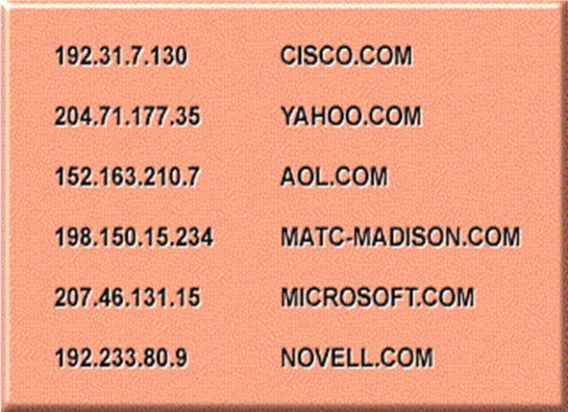
Domain Name System (DNS)
The Domain Name System (DNS) is a service on a network that manages domain names and responds to requests from clients to translate a domain name into the associated IP address.

Slide 24
Domain Name
3-lever
domain
2-lever
domain
Top lever
domain
www.sina.com
Corporation
Sina
Computer name to provide the www services

Slide 25
TLD (Top Level Domain)
Nation TLD(nTLD)
.cn(CHINA), .us (United States), .uk (United kingdom), etc.
Generic TLD(gTLD), the earliest domains include:
.com Enterprises and companies
.net Network services providers
.org Nonprofit organizations
.edu Educational facilities
.gov Governments (only for U.S.A)
.mil Military facilities (only for U.S.A)
.int International organizations

Slide 26
TLD (Top Level Domain)
Infrastructure domain
Only one: arpa, for resolving domain names reversely
Recently, new TLD domain added:
.aero （航空运输企业）
.biz （公司和企业）
.cat （加泰隆人的语言和文化团体）
.coop （合作团体）
.info （各种资讯）
.jobs （人力资源管理者）
.mobi （移动产品与服务的用户和提供者）
.museum （博物馆）
.name （个人）
.pro （经过认证的专业人员）
.travel （旅游业）

Slide 27
Domain Name Server (DNS)
.
com
edu
gov
cn
fr
uk
vnn
com
edu
gov

Slide 28
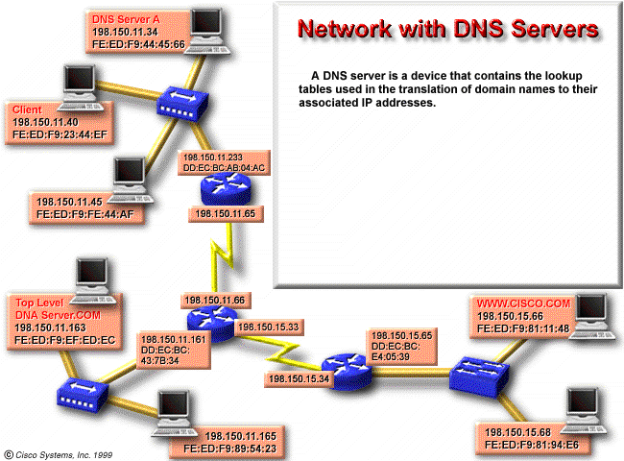

Slide 29
Domain Name Server (DNS)
The DNS system is set up in a hierarchy that creates different levels of DNS servers.
The DNS server at this level judges if itself is able to translate the domain name into an associated IP address:
If it can do that, it does so and returns the result to the client
If not, it sends the request to the higher level.

Slide 30
Application Layer: Communication Ways
One way that communication processing takes place:
When a browser opens, it is connected to the default page and the files of the page are transferred to the client.
After the processing is completed, the connection is broken
The second way:
As Telnet and FTP, establish a connection to the server and maintain that connection until all processing is performed.
The client terminates the connection when the user determines that he/she has finished.
All communication activity falls into one of these two categories.

Slide 31


谢 谢！

